Slide 1
What’s New?
Keith Martin
keith.martin@nortonrosefulbright.com

Slide 2
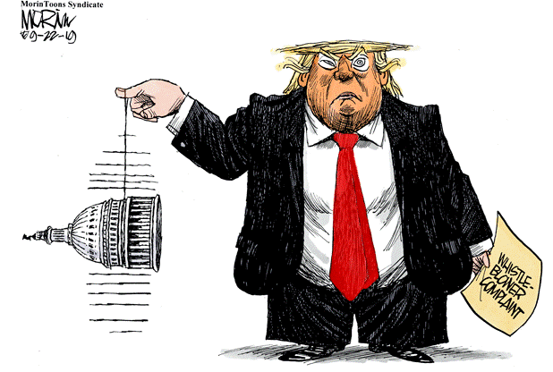

Slide 4
CFOs are wondering whether they need to spend money before year end to start construction of new solar projects. SEIA is making a major push to extend the ITC, but the proposal faces long odds. All eyes are on a potential extenders bill at year end.
House 3/36
Senate 0/16

Slide 5
Chances of an ITC extension improve after 2020 depending on the election results. There is a growing sense in Washington that the government will have to employ whatever tools it can to make up for lost time on climate change.

Slide 7
Solar companies are pursuing various construction-start strategies. Solar panels have become hard to find, so most questions lately have been about stockpiling racking or about physical work on concrete footers and posts on site and starting work at the factory on transformers.
spectrum
tax equity market

Slide 8
Wind companies face a different challenge. They are coming up against the second of two deadlines -- to finish construction. The IRS allows four years. Anyone taking longer must prove continuous work after construction started. The tax equity market is expected to finance projects where developers can prove "continuous efforts."

Slide 9
Among the many questions developers are asking is whether they can shed an early construction start by simply not using physical work. The IRS view is there must be a business reason.

Slide 11
The wind industry has not made a push so far to extend tax credits for its projects. Such projects are expected to enjoy an advantage of 1¢ a KWh in LCOE versus solar after 2023 once tax credits phase out. The advantage will erode if solar projects continue to qualify for large tax credits while wind projects do not.
technology-neutral credit

Slide 12
Three other tax proposals of interest to the renewable energy community are in play in Congress, but also face long odds this year due to gridlock. Hill tax staff and DC lobbyists rank their chances in the following order: standalone storage, offshore wind, free transferability.

Slide 13
Tariffs remain a significant hazard to developers who have locked in electricity prices in signed PPAs. An exemption from solar panel tariffs for bi-facial panels is at high risk of being reversed. Trump accused Vietnam in June of "taking advantage of us even worse than China." Most panel suppliers are now putting tariff risk on the customer.
India deal?
wind towers

Slide 14
Developer fees are in less favor after a court decision in June barring developer fees from being added to tax basis to calculate Treasury cash grants on two wind farms. The case has moved to a US appeals court. Invenergy filed its brief in the appeal on September 12.
California Ridge Bishop Hill

Slide 15
The biggest risk in solar deals remains the tax basis used to calculate tax benefits. Another case the industry is watching closely, involving the Alta wind farms in California, is headed toward a retrial, possibly as early as the spring.
tax insurance premiums

Slide 16
Partnership flip yields in the utility-scale solar market are in the 6.25% to 6.8% range. Inverted lease transactions that price in dollars per ITC are in the $1.07 to $1.14 range for projects going into service in 2019. Wind partnership flip yields are largely in the same range as solar flip yields, with reports in isolated cases of dropping below 6%. Interest rates are 75 bps for construction debt and 125 bps over LIBOR for term debt for fully contracted projects.

Slide 17
Power prices are below operating costs for coal and nuclear plants in many markets. Operating costs for gas are 3-4¢ a KWh, coal 3.5-5¢ and nuclear 4-5¢. Solar + storage operating costs are expected to be 3-4¢ after 2023. Wind is expected to be 2-3¢ without PTCs. Storage today adds 1¢ per KWh on average.
SPWR: 25% storage

Slide 18
New regulations on what qualifies for investment credits are almost certain to slip into next year. IRS regulations on tax credits for carbon sequestration could be out by year end. Once they are out, a number of coal sequestration projects should start to move. The IRS is expected to decide this fall whether independent power companies can add back depreciation to taxable income through 2021 when calculating the 30% cap on interest deductions.

Slide 19
Electrification of the transportation sector has the potential to increase electricity demand. However, replacing all 200 million cars would lead to only a 14% increase. We are at 1 million EVs in the US today. The fact that many millennials don't want to own cars makes adoption rates harder to forecast. US EV sales increased by 40% in 2018, but the number of public charge points increased by only 2%.

Slide 20
Opportunity zones have been a disappointment so far to renewable energy developers who had been looking at them as a possible source of equity for their projects. IRS regulations to use them are extremely complicated. Trying to tap into opportunity zone funding is like trying to navigate through an intricately constructed maze.
NYTs
new regulations

Slide 21
The level of service from government agencies has become noticeably worse. Only 33% of taxpayers got through to the IRS after an average wait of 41 minutes during the last filing season. The US Customs office that fields questions about tariffs no longer answers the phone. Customs agents at busy airports are sometimes bewildered about what tariff rates to apply to goods that returning Americans bring back with them from overseas.
3,892 pages

Slide 22
Number of state legislatures that are controlled by a single party:
49

Slide 23
Percentage change in women's math test scores in a room that is between 80˚ and 90˚F rather than 60˚ and 70˚F:
+27%

Slide 24
In men's math test scores:
-7%

Slide 25
What’s New?
Keith Martin
keith.martin@nortonrosefulbright.com

