Slide 1
Transmission Planning and Interconnection
Independent Energy Producers Annual Meeting
September 24, 2024

Slide 2
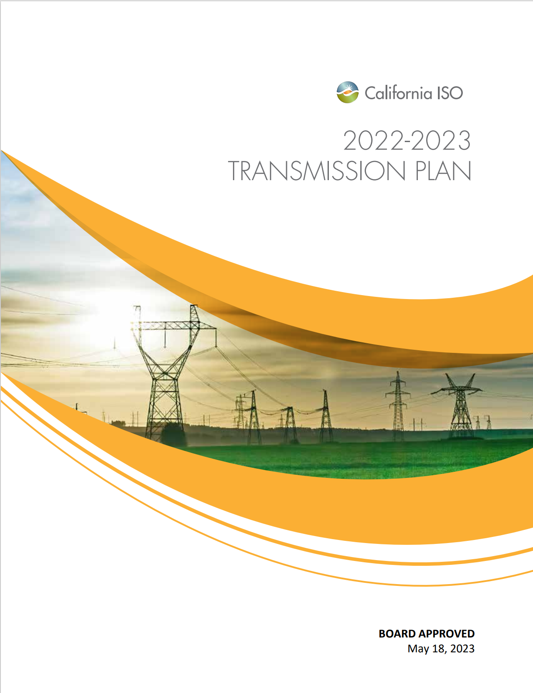

The ISO leads the transmission planning process for our footprint, coordinated with load forecasts from the CEC and resource planning from the CPUC
Annual 10-Year transmission plan is the formal approval document for expansion planning in our footprint
  Ramped from 10 year average of $650 million per year to $3 billion in 2021-2022 plan, $8.1 billion in 2022-2023 plan and $6.1 billion in the 2023-2024 plan
  Responded to accelerating load growth and escalating renewable energy needs
  Focuses on most efficient and effective long term solutions – including Grid Enhancing Technologies and non-wires solutions
20 Year Outlook assesses longer term needs
  First prepared in 2022, updated in 2024
  Establishes a longer term direction and strategy
  Provides context for nearer term decision
  Informs going-forward resource planning decisions
FERC Order No. 1920 will require changes and add new considerations to regional transmission planning.

Slide 3
Transmission Planning and Generation Interconnection are two of four fundamental and interwoven processes:
The CPUC/CEC/ISO Memorandum of Understanding signed in December, 2022 sets the strategic direction for process improvements to:
Tighten the linkage between planning, procurement direction, and the ISO interconnection process to the greatest extent possible.
Create formal linkage between CEC SB 100/IEPR activities and the ISO and CPUC processes
Reaffirm the existing state agency and single forecast set coordination
Update references to current processes and set direction to updating process documentation
Resource Planning
Resource planning led by CPUC setting out resource-rich areas and quantities
Transmission Planning
Transmission planning identifying upgrades and enabling zones
Resource Procurement
Load-serving entities focus on zones where capacity exists or is being developed
Interconnection Process
Interconnection process efforts are prioritized in the preferred zones

Slide 4
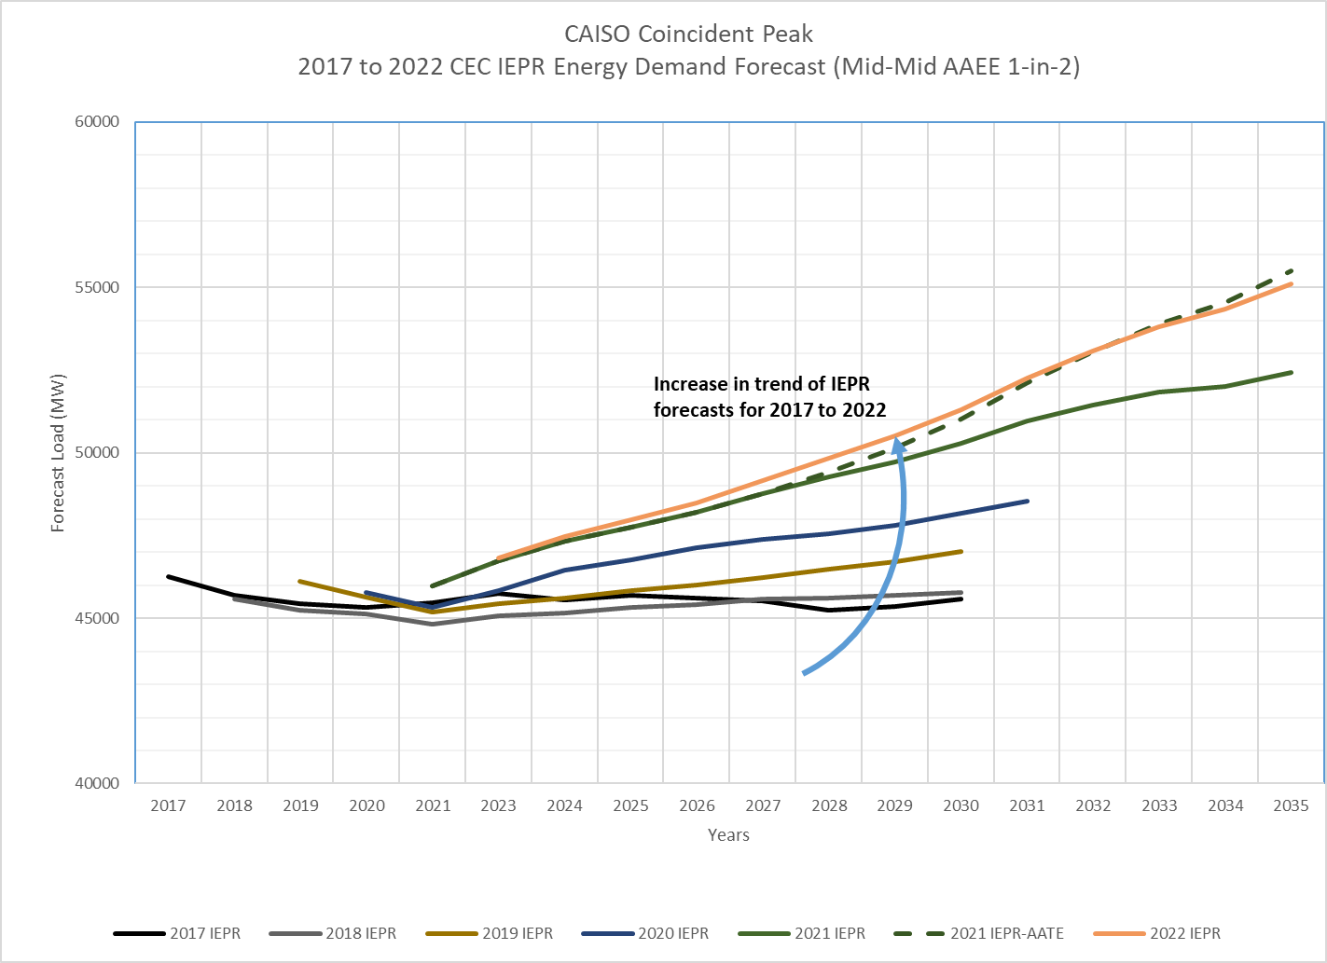
California’s climate change goals are driving escalating load forecasts
The CEC’s load forecast is used in both the CPUC’s Integrated Resource Planning process and the ISO’s transmission planning process.
The ISO uses:
1-year-in-10 weather event forecast for local reliability studies
1-year-in-5 weather event forecast for bulk system reliability-driven and policy-driven studies
1-year-in-2 weather event forecast for economic (market efficiency) studies
Notes:
The climate change goals continue to drive the load forecasts that can be seen in this graph. The CEC’s load forecasts are utilized by both the California Public Utilities Commissions integrated resource planning and the ISO’s transmission planning process as a part of the single forecast set, with the applicable weather event forecast used for the specific studies as indicated.
The ISO has utilized the CEC’s 2022 IEPR update forecast, the top yellow line, in the 2023-2024 transmission planning process.

Slide 5
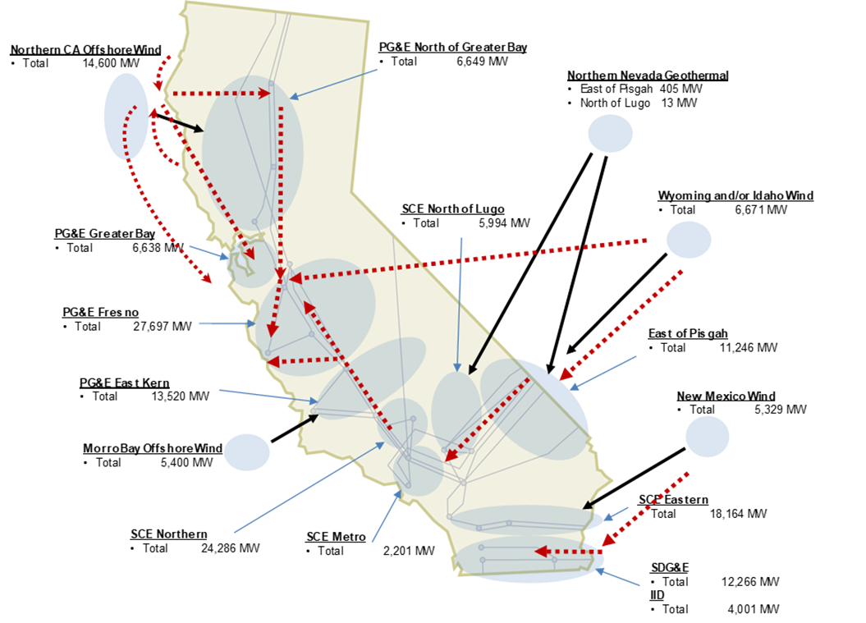
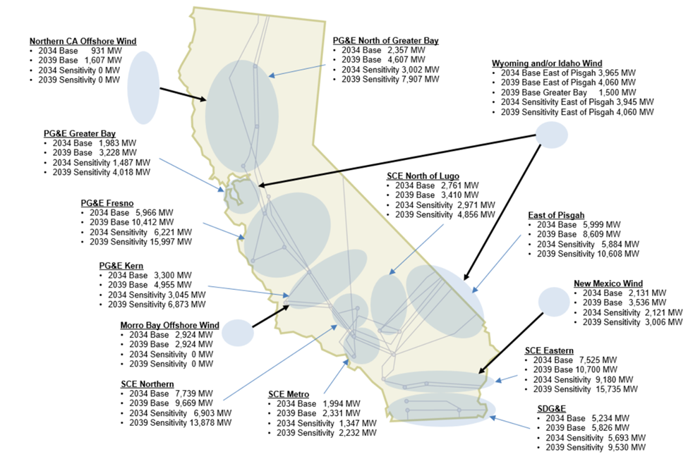
ISO transmission planning process continues to use zonal approach which enables clear direction and prioritization
CAISO 2024 20-year Transmission Outlook
ISO 2024-2025 Transmission Planning Process
Notes:
As I indicated earlier, the 2023-2024 Transmission Plan continues to the zonal approach to plan the transmission for the resources identified in the portfolios to enable clear direction and prioritization in the resource interconnection and procurement process.
The diagram on the left is from the May 2022 ISO 20-Year Transmission Outlook which we are in the process of updating this year.
The diagram on the right identifies the interconnection zones with the capacity of resources in the portfolios for each of zones that the ISO is planning the transmission system to reliably interconnect the resources and be deliverable to loads in the ISO grid.

Slide 6
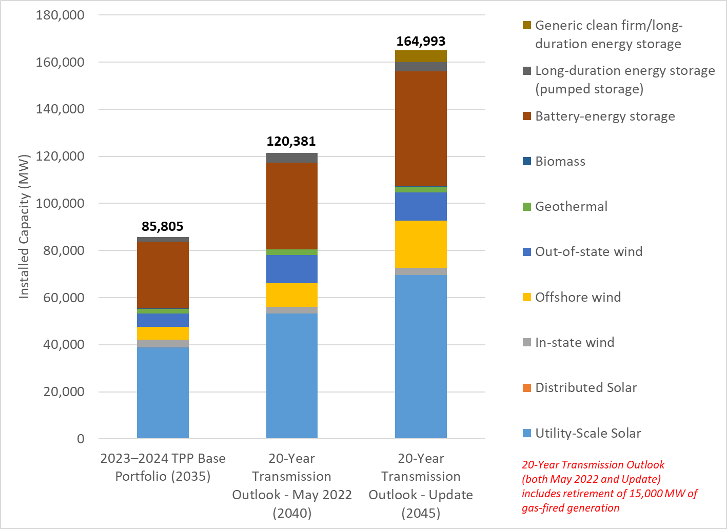
Portfolios – 2023-2024 Transmission Planning Process and 20-Year Transmission Outlook
Notes:
The climate changes goals and load forecasts has also lead to unpreceded resource needs.
The base portfolio for this year’s planning cycle has about 85 GW of new renewable resources by 2035.
The center bar chart represents the resource portfolio from the May 2022 20-Year Transmission Outlook for the year 2040 while the last bar indicates the portfolio being assessed for the update of the 20-Year Transmission Outlook in the year 2045 that is currently under development.
This puts the resources in the portfolios we are planning the transmission system to on the trajectory to meet the states goals as reflected in the ISO 20-Year Transmission Outlook

Slide 7
Studies are coordinated as a part of the transmission planning process
Reliability Driven Projects meeting Reliability needs
Commitment for biennial 10-year local capacity study
Policy Driven Projects meeting Policy and possibly Reliability needs
Assess local capacity areas
Economic Driven Projects meeting Economic and possibly Policy and Reliability needs (multi-value)
Subsequent consideration of interregional transmission project proposals as potential solutions to regional needs...as needed.

Slide 8
Current circumstances necessitate transformative changes to the interconnection process
Interconnection requests continue to skyrocket
  Many in areas not part of state resource plans, and in high volumes even in those areas
  Cluster 15 in April 2023 vastly exceeded expectations
  The queue now has roughly three times the capacity of that which will be needed to achieve California’s 2045 requirements
C15 Active Projects
347 GW
C14 Active Projects
94 GW
C14 and Prior: ~185 GW Active Projects

Slide 9
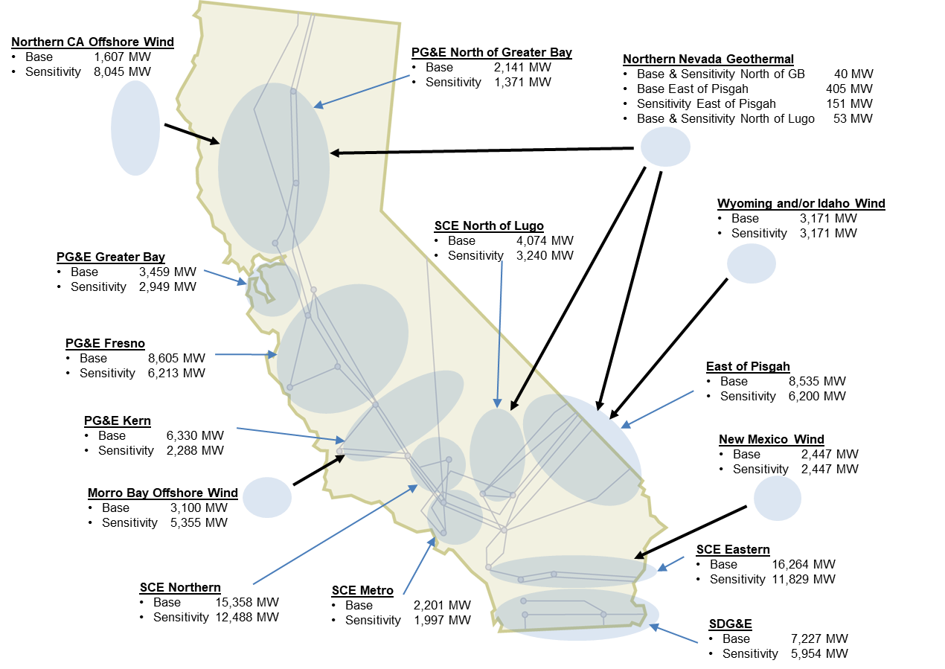
Prioritize interconnection studies in areas with available and planned transmission capacity
Designate zones as Transmission Plan Deliverability (TPD) or merchant zones based on the project’s Point of Interconnection (POI) to determine if a project can move forward to scoring.
ISO 2023-2024 Transmission Plan
Determine which projects advance to the study process using project score, distribution factor, and 150% of available capacity for each known area constraint.
150% ensures sufficient capacity for study and competition for deliverability and offtake after the study process.

Slide 10
Score projects based on the interconnection customers’ self-assessment and load-serving entity selections
Commercial interest (30%): Incorporate LSE and offtaker interest early to ensure the most commercially ready projects advance to the study process
  LSE allocation process (0 to 100 points, based on percentage of capacity of the project awarded by LSEs)
  Non-LSE interest (0 or 25 points)
Project Viability (35%)
  Completeness of an engineering design plan (0-50 points)
  Expansions of facilities under construction or in operation (10, 20, or 50 points)
System need (35%)
  Projects that can provide Local RA (50 points)
  Long lead-time resources (100 points)

Slide 11
Transformative change is critical to adapting to increased demand and competition for new generation
The ISO prioritizes alignment with
  state and local resource plans
  transmission availability
  procurement needs and interests
Projects will need to compete for the right to be studied.
Action is critical to address lengthening interconnection delays.
Continued coordination with the CEC and CPUC is both unique and critical.

