Slide 1
Washington and Market Update
Keith Martin
keith.martin@nortonrosefulbright.com

Slide 2
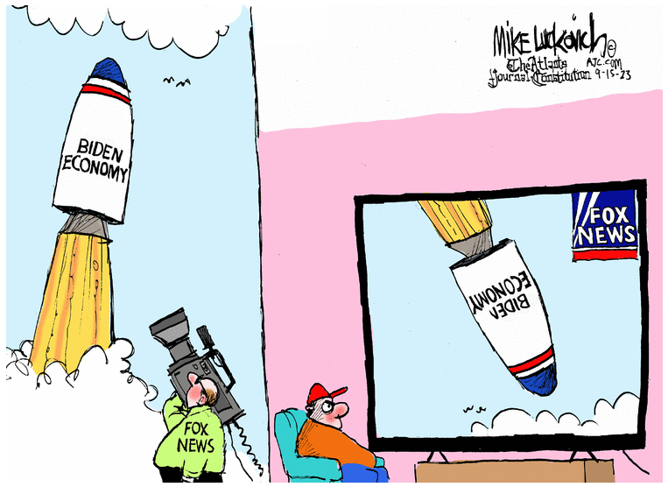

Slide 3
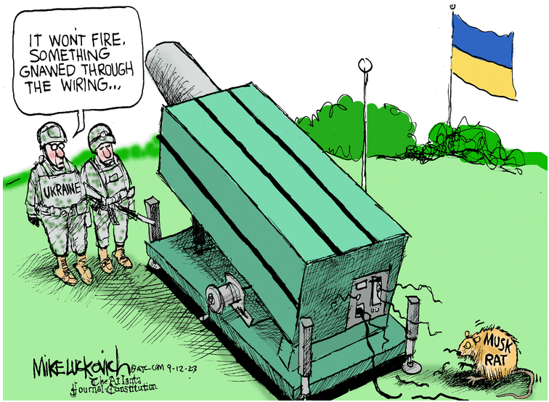

Slide 4
The tax equity market could take a major hit from new proposed rules to implement Basel III. US bank regulators want to quadruple the risk weighting -- from 100% to 400% -- for tax equity partnership interests and other non-publicly-traded equity. Such investments would require four times the regulatory capital that they do today, starting in 2025. Some banks are pausing new investments while others are adding funding outs.

Slide 5
The odds are high of a federal government shutdown at the end of the month. The Inflation Reduction Act provides funding for the Treasury and IRS to continue working through the shutdown on IRA guidance.

Slide 6
A number of big policy issues remain in play. The Inflation Reduction Act was a long bill, but can be distilled to two basic points.

Slide 7
The government will fund a large share of the cost of new renewable energy facilities. Developers will receive tax credits worth as much as 70% of the project cost. Manufacturers of wind, solar and storage equipment and producers of a long list of minerals will also receive significant subsidies.

Slide 8
Here is how the math works for developers:
30% base tax credit
10% for domestic content
10% for energy communities
10% to 20% for LMI

Slide 9
The subsidies will remain in place for a long time. The tax credits for developers will not start phasing out again until two years past the year greenhouse gas emissions from the US power sector fall at least 75% from 2022 levels. That will not happen before 2034 at the earliest.

Slide 10
Here is how the math works for solar manufacturers:
4¢/watt for solar cells
$12/m² for wafers
$3/kg for polysilicon
40¢/m² for polymeric backsheets
7¢/watt for solar modules
87¢/kg for torque tubes
$2.28/kg for structural fasteners

Slide 11
Here is how the math works for battery manufacturers:
10% of cost of electrode active materials
$35 a KWh for battery cells
$10 a KWh for battery modules

Slide 12
Manufacturers can have these tax credits paid to them in cash by the IRS for five years. This will lead to large cash infusions from the US government for companies like Vestas and First Solar.

Slide 13
The Treasury released a list on September 7 of guidance that it hopes to issue by year end. Issues involving labor, individuals and US factories take priority.

Slide 14
Guidance on section 45X tax credits for manufacturers is farthest along and is expected in late October. Two significant issues are whether manufacturers of devices with electricity in and thermal out, or vice versa, qualify as batteries and whether clips that bolt solar panels to trackers are "structural fasteners."

Slide 15
New ITC regulations are probably next. They should answer the question whether PTCs can be claimed on the electricity output from renewable energy projects while ITCs are claimed on co-located batteries. Offshore wind companies hope for confirmation that ITCs can be claimed on export cables that bring electricity to shore.

Slide 16
The lobbying on section 45V credits for making clean hydrogen has been intense. The Treasury missed an August 16 statutory deadline. The policy calls will be have to made by the White House. The "three pillars" -- availability, deliverability and matching -- remain in play. Another issue is whether tax credits be claimed on hydrogen if it is only an intermediate chemical step to make something else, like ammonia or methanol.

Slide 17
Most developers have been focused on how to stack bonus tax credits. The IRS published tables that make it easy to check whether projects are in "energy communities." JPMorgan said roughly 50% of the solar projects it sees this year qualify.

Slide 18
The rules for LMI bonus credits are absurdly complicated. Treasury is expected to announce shortly when it will start taking applications for the 1,800 MW in such credits it has to allocate this year.

Slide 19
The domestic content guidance was a bust. It requires manufacturers to disclose three costs to developers, which most manufacturers are loathe to do. First Solar stock increased 26.48% immediately after the guidance was issued, but then gave up the entire gain over the next month in a sign the market was having trouble figuring out how the guidance works.

Slide 20
Revisions are not expected before year end. Developers in the meantime are taking two approaches in procurement contracts. Wind projects are not expected to be able to satisfy the domestic content thresholds before 2026 due to the need for all of the steel tower manufacturing processes to take place in the US. Stock analysts say solar can't qualify unless the cells are made here.

Slide 21
The IRA tax credits come with fine print. Mechanics and laborers must be paid the same wages that are paid on federal construction jobs during construction and during the next five to 12 years after the project is operating on alterations and repairs. Apprentices must be used for 12.5% to 15% of total labor hours.

Slide 22
Construction contractors are rejecting contract clauses that require them simply to comply with what the law requires. They want to be told by developers specifically what to do.

Slide 23
Many people have been asking whether the IRA could be repealed. Trump-aligned policy groups are planning for a 180-degree turn in US policy to resume promoting fossil fuels and roll back the IRA. A full rollback will be more challenging the more time that passes.

Slide 24
The Treasury is moving directly to proposed regulations in place of notices after looking at the calendar. The Congressional Review Act would let a newly-elected Republican Congress in 2025 force withdrawal of any final regulations issued within the last 60 days of the current Congress.

Slide 25
The tax credit sales market is ramping up quickly. Most tax credits are trading in the 90¢ to 93¢ range. Deals move quickly, but they are "tax equity lite" rather than two-page bills of sale. Accommodation parties are pitching structures to step up the tax basis on ITC assets like happens in a tax equity deal. Concerns about ITC recapture after bank foreclosures have left some ITC sales stalled.

Slide 26
Customs detentions under the UFLPA are now starting to extend to lithium-ion batteries. Rumors are that Customs will start focusing on second-tier solar panel suppliers now that the bigger suppliers have either reworked supply chains or run the gauntlet. Customs is requiring batch-specific detailed documentation through the entire supply chain back to the mine.

Slide 27
The SEC is poised as early as October to require public companies to report the risks that climate change poses to their business models. The agency received 15,000 comments on proposed disclosure rules in March 2022.

Slide 28
The California legislature completed work on two bills last week that would impose state-level reporting obligations on companies doing business in California with annual revenues of more than $500 million for one bill and more than $1 billion for the other. The legislative counsel said this will affect 10,000 companies.

Slide 29
Capital costs are up across the board. SOFR moved from under 1% to 5.3% in the last year. The spread on debt widened from 125 bps to 178 bps, and is pushing toward 200. Tax equity flip yields are up at least 100 basis points in the last year and are generally in the mid-7% range.

Slide 30
Percentage of information on the internet that is expected to have been generated by AI in a few years' time:
90%

Slide 31
The state where the most people stay put after birth:
Texas (82.2%)

Slide 32
Least sticky state:
Wyoming (45%)

Slide 33
Washington and Market Update
Keith Martin
keith.martin@nortonrosefulbright.com

