Slide 1
Extended Day-Ahead Market (EDAM): Building on the existing benefits of regional coordination in the West
Milos Bosanac
Regional Markets Sector Manager, Market Policy Development (CAISO)
IEPA Annual Meeting 2023

Slide 2
Expanding regional collaboration and coordination will produce significant benefits for retail customers across the West
Economic
Reliability
Environmental

Slide 3
Western Energy Imbalance Market: Economic benefits from the West’s existing market
WEIM provides a unified, real-time market across most of the West that allows utilities to efficiently manage imbalances.
The WEIM has grown significantly since 2014, creating substantial economic benefits for utilities and ratepayers.
These benefits accrue to participating utilities and provide cost reductions for retail customers.
$4.2 billion
WEIM benefits since 2014
22 Balancing Areas
80% of demand in West
64% of benefits
accrued to BAs outside CA

Slide 4
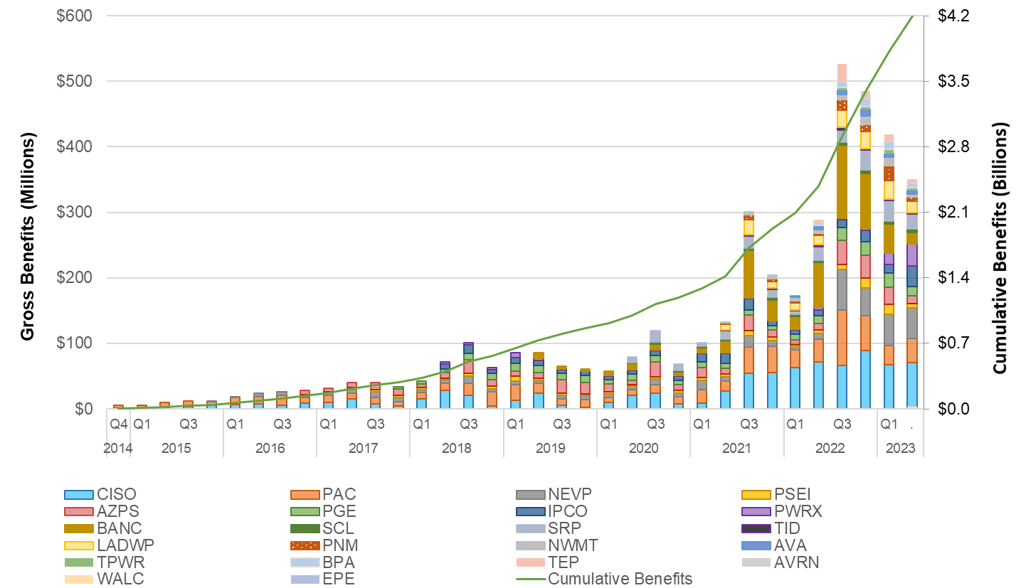
Western Energy Imbalance Market: Delivering significant value to the West today

Slide 5
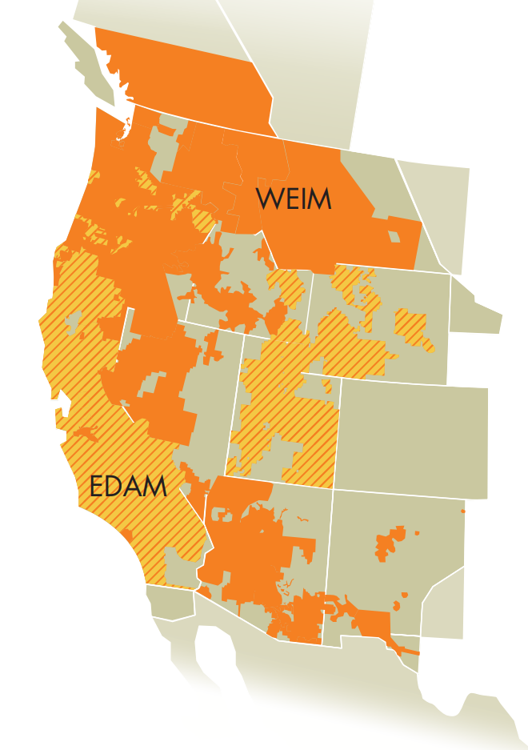
Extension of the Day Ahead Market (EDAM)
An extension of the day ahead market across the West allows for optimized commitment of generation in the day ahead timeframe.
EDAM entities continue to retain key responsibilities: resource planning, transmission planning and reliability operation functions.
PacifiCorp (PAC) and the Balancing Authority of Northern California (BANC) have indicated their intent to join the EDAM.

Slide 6
EDAM builds on the economic, reliability, and environmental benefits afforded through the WEIM
ECONOMIC
RELIABILITY
ENVIRONMENTAL
Optimized unit commitment across a wide footprint
Production cost savings in serving load with least cost supply
Studied incremental benefits of a Western day ahead market range upward of $543M to $1.2B annually
Increased situational awareness - visibility of supply and grid conditions across footprint
Improved operational confidence – positioning supply to meet changing conditions and uncertainty across the footprint
Reducing emergency declarations by positioning footprint confidently in day ahead timeframe
Sharing of surplus clean energy in day ahead timeframe across footprint
Reduction in curtailments of low emitting resources
Supporting diverse state regulatory environmental policies

Slide 7
EDAM Design: Overview of key elements
Voluntary Participation
WEIM entities can extend participation to EDAM, easy of entry and exit.
Daily Resource Sufficiency
Compatible with different RA programs, tests supply sufficiency to meet next day obligations.
Transmission Availability
Maximizing transmission availability to support transfers between areas while respecting OATT rights.
Optimization
Market efficiently commits supply across the footprint to meet next day conditions.
Imbalance Reserves
Introduction of imbalance reserve product to manage uncertainty between day ahead and real time.
GHG Accounting
Extending the current WEIM “resource specific” approach, resources can elect whether to commit to serve load in GHG area.

Slide 8
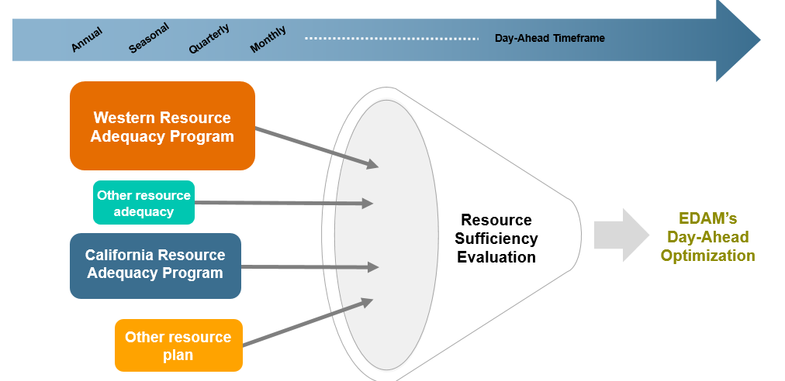
EDAM Resource Sufficiency Evaluation
Daily evaluation that EDAM entity offers sufficient supply into the market to meet next day expected obligations across the 24-hour horizon.
Forecasted demand
Uncertainty requirement
Ancillary services
Daily sufficiency evaluation as a common measure across diverse resource adequacy and resource planning programs.

Slide 9
Optimizing Transmission in EDAM & Respecting OATT Rights
Transmission system flow capability within an EDAM area is available to support optimized unit commitment and transfers.
Transmission providers and transmission customers make firm/conditional firm transmission available at interties between EDAM areas for optimization.
Can exercise OATT rights in day ahead market, release them to market for optimization, or leave them unscheduled.
OATT rights can also be exercised in the real-time market, if unscheduled in the day ahead market.
Market redispatch to accommodate new schedules, new uses
Deference to transmission provider to inform market on treatment of schedules exercising OATT rights and resolving infeasibilities on their system

Slide 10
Opportunity remains to continue evolving regional governance to facilitate a single Western market and unlock greater economic, reliability, and environmental benefits
Coordinated long-term planning
Resource adequacy
Transmission access
RTO
Single control & planning area
A regional, multi-state entity under independent governance
Transmission provisioning
Resource sufficiency
Efficient resource commitment
EDAM Day-ahead market
Market governance
considerations
Under joint governance
The EDAM will cover the complete wholesale market from Day-ahead to Real-time
Bid-to-bill
Full network model
Metering
WEIM
Real-time market
Under joint governance
The WEIM achieves efficient “last minute” trading across participating regions

Slide 11
Continuing to Evolve the Design of Markets
GHG Accounting Coordination working group focused on design evolution, consideration of diverse GHG reduction programs in the West, and market participant data needs.
Price Formation Enhancements working group focused on scarcity pricing, fast start pricing, and market power mitigation design.
Gas Resource Participation working group focused on exploring potential enhancements in reflecting gas resource participation and cost recovery recognizing diverse resources and gas systems across the West.

Slide 12
EDAM Milestones
2021-2022 – Extensive stakeholder engagement to develop EDAM proposal
February 2023 – EDAM design approved by ISO Board of Governors and WEIM Governing Body
August 2023 – EDAM tariff filed with FERC
December 2023 – expected FERC decision on tariff filing
2024-2025 – Implementation work for CAISO and EDAM entities
2026 – Target “go-live”, coordinated with participants

Slide 13
Stay connected
California ISO
ISO Today mobile app
California ISO
Daily Briefing
Sign up for
Flex Alerts
Follow us on social media.

